Slide 1
Sprint 2 Demo
Environmental Justice league.
( Jiaqi Xu, Baldwin Edwards, Alissa Martini)

Slide 2
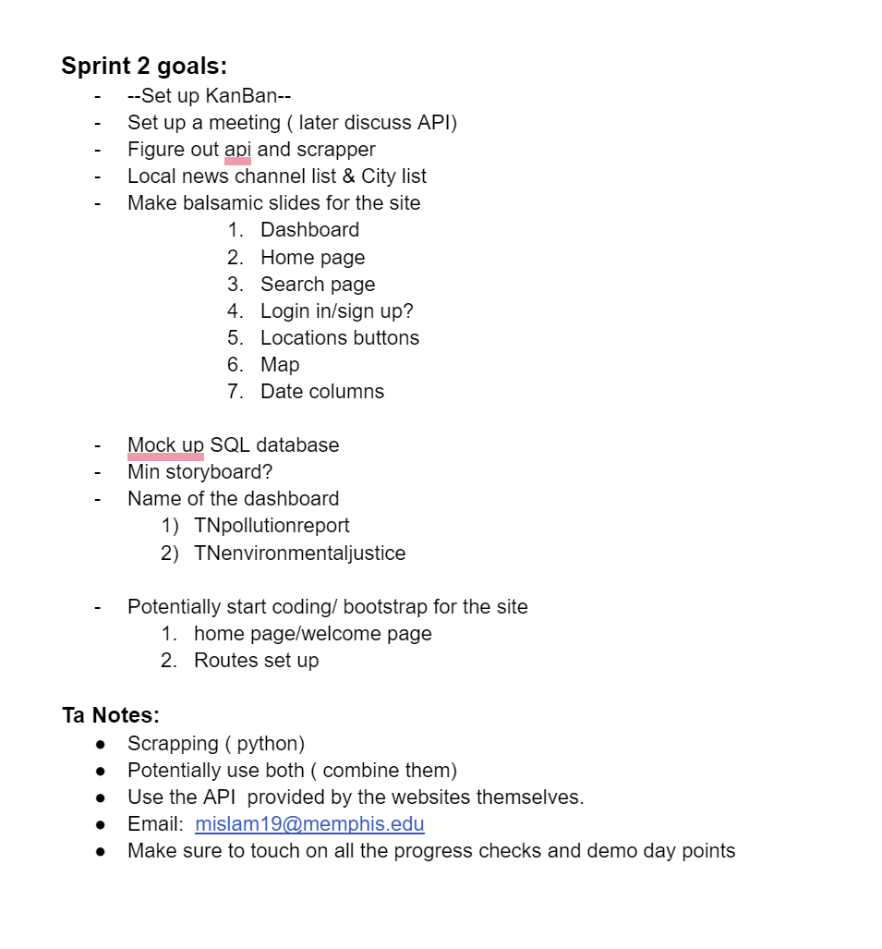
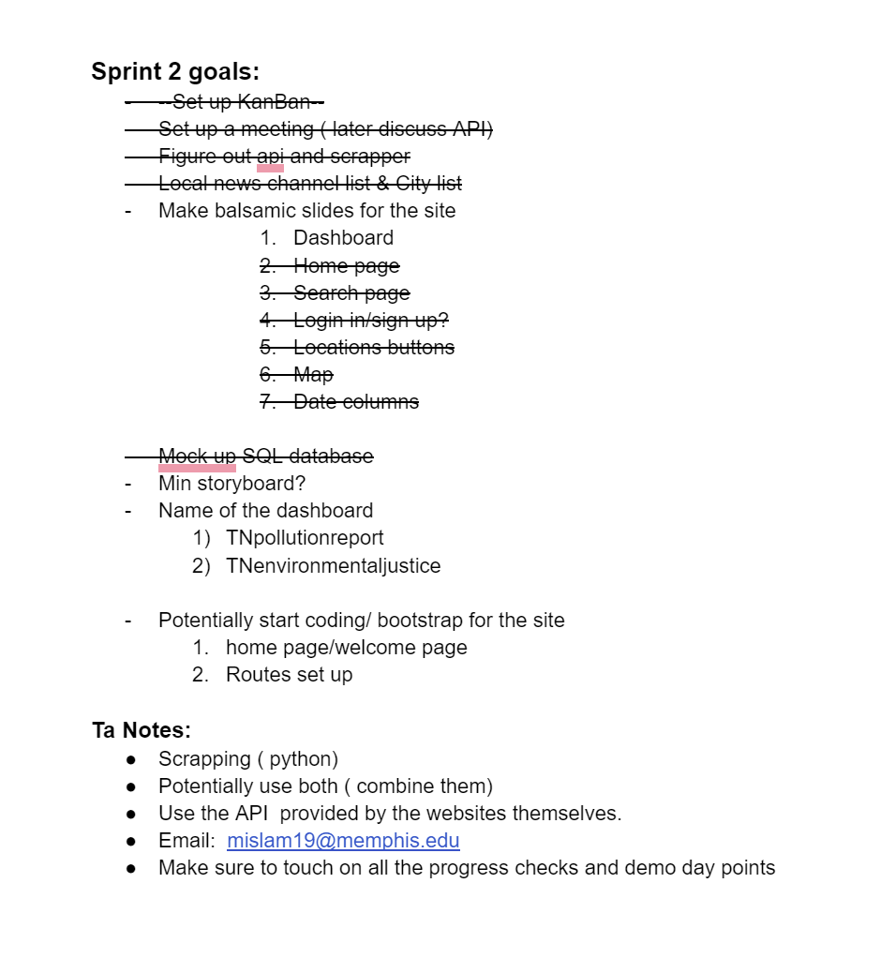
Initial Sprint Two Goals :
Goals that were Accomplished:

Slide 3
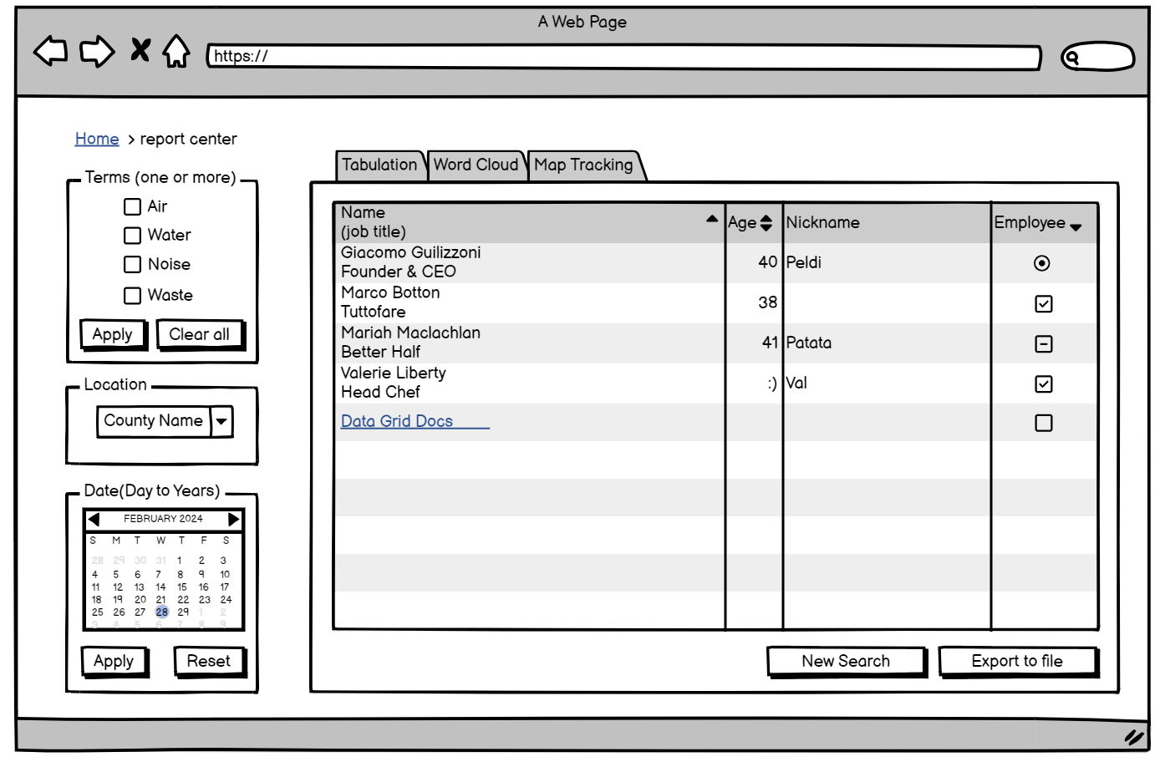
Previous design
This was our original design idea for the homepage in sprint 1
Everything was on the one page
The filters
The tabs to other features such as the cloud word map, the actual location tracking map.

Slide 4
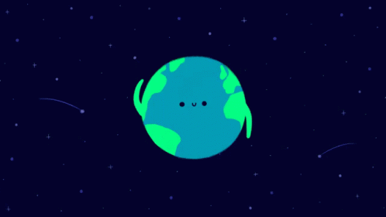
What new since sprint 1?
Quite a bit actually…

Slide 5
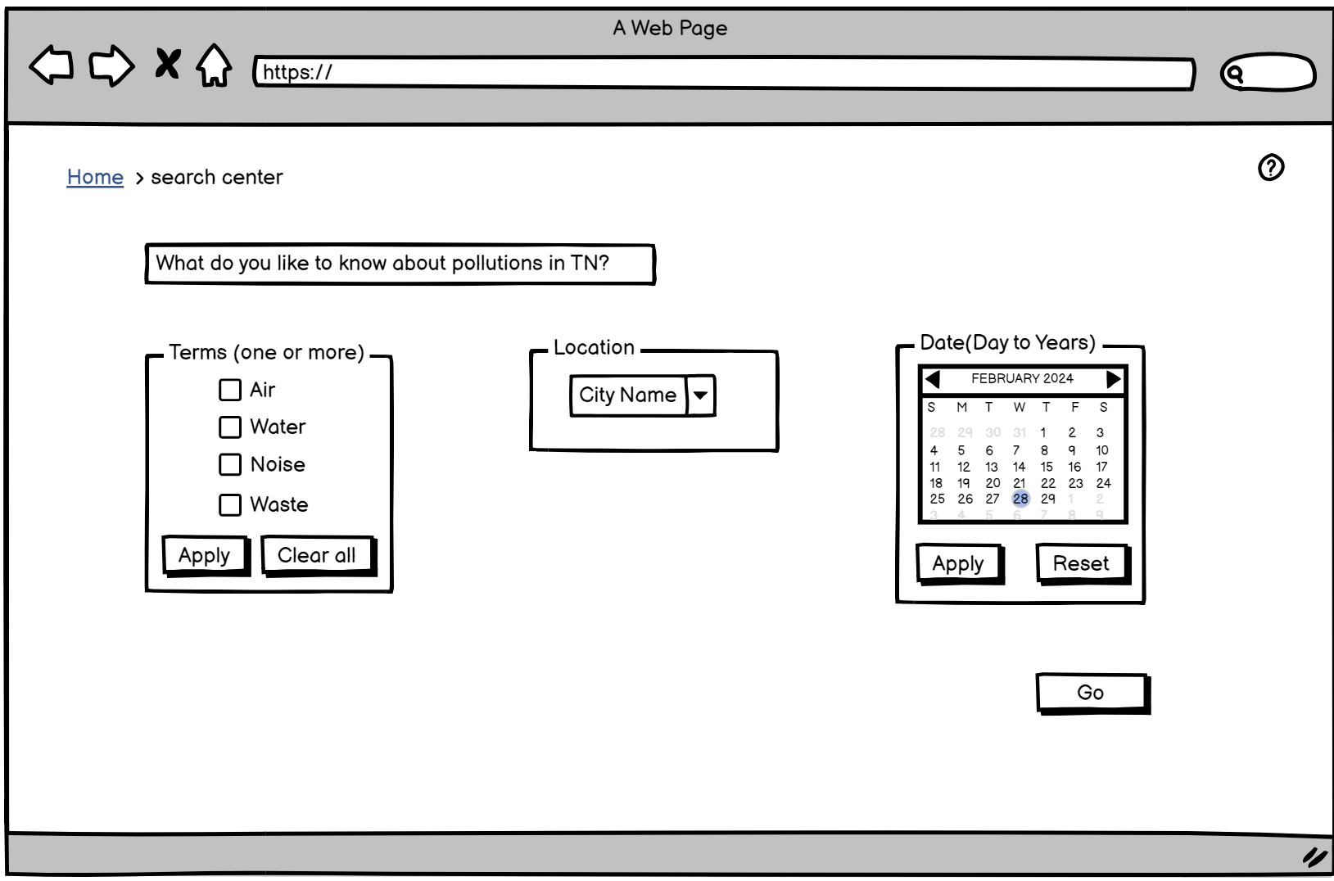
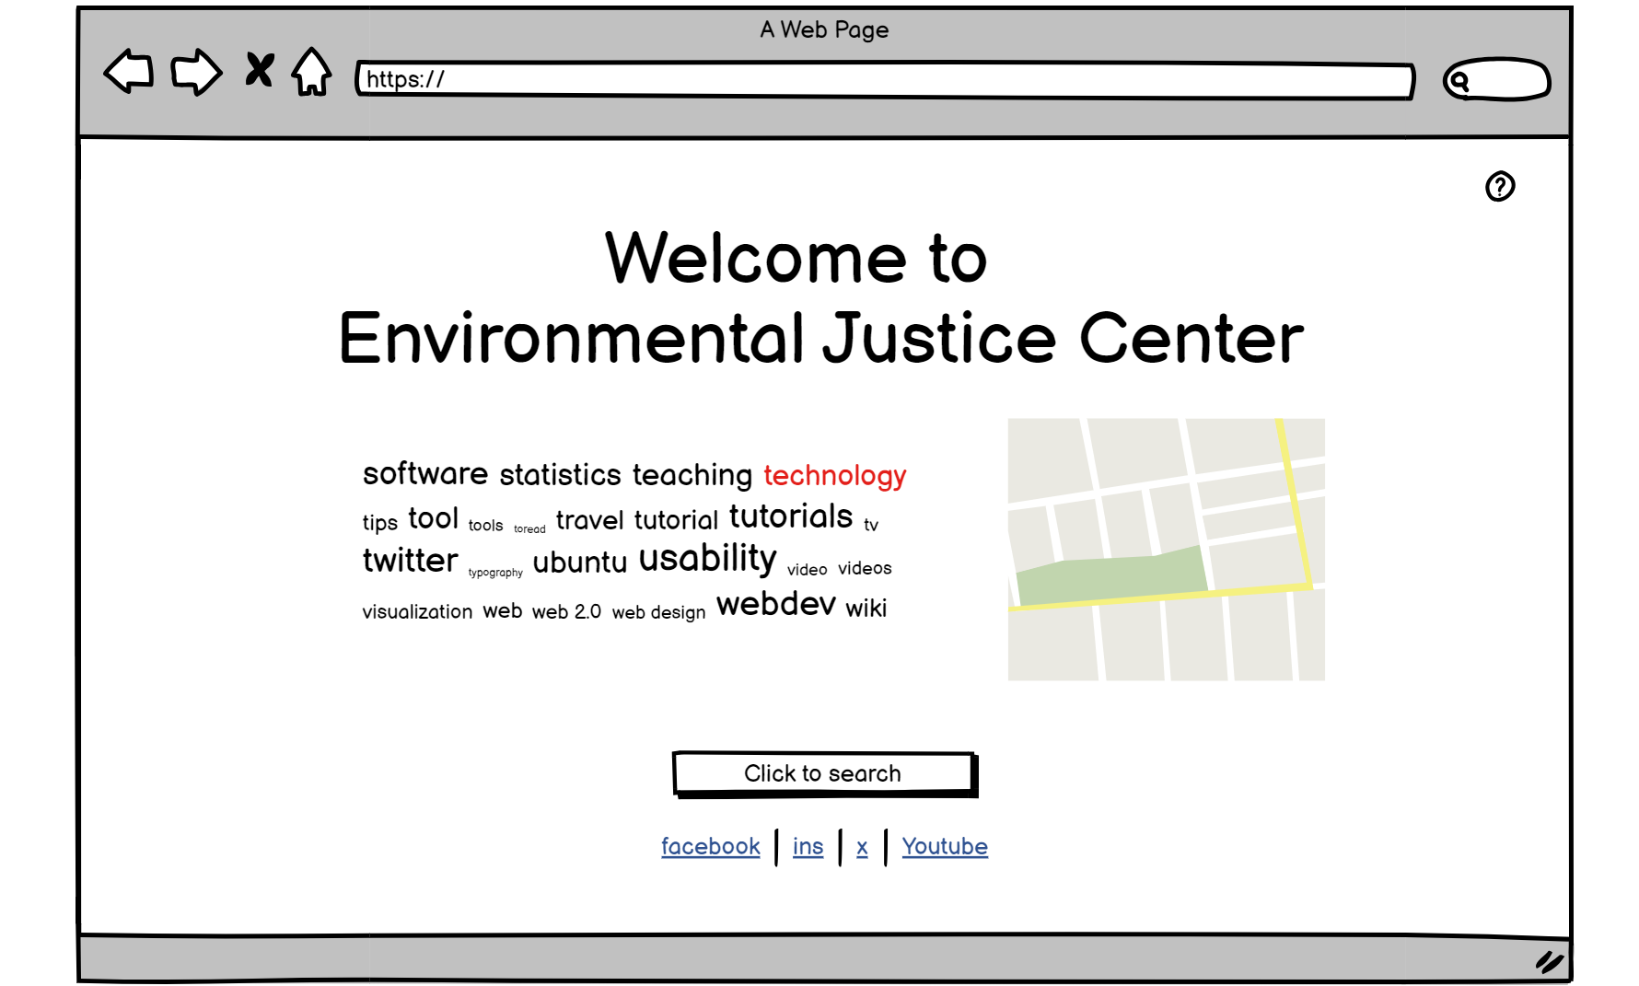
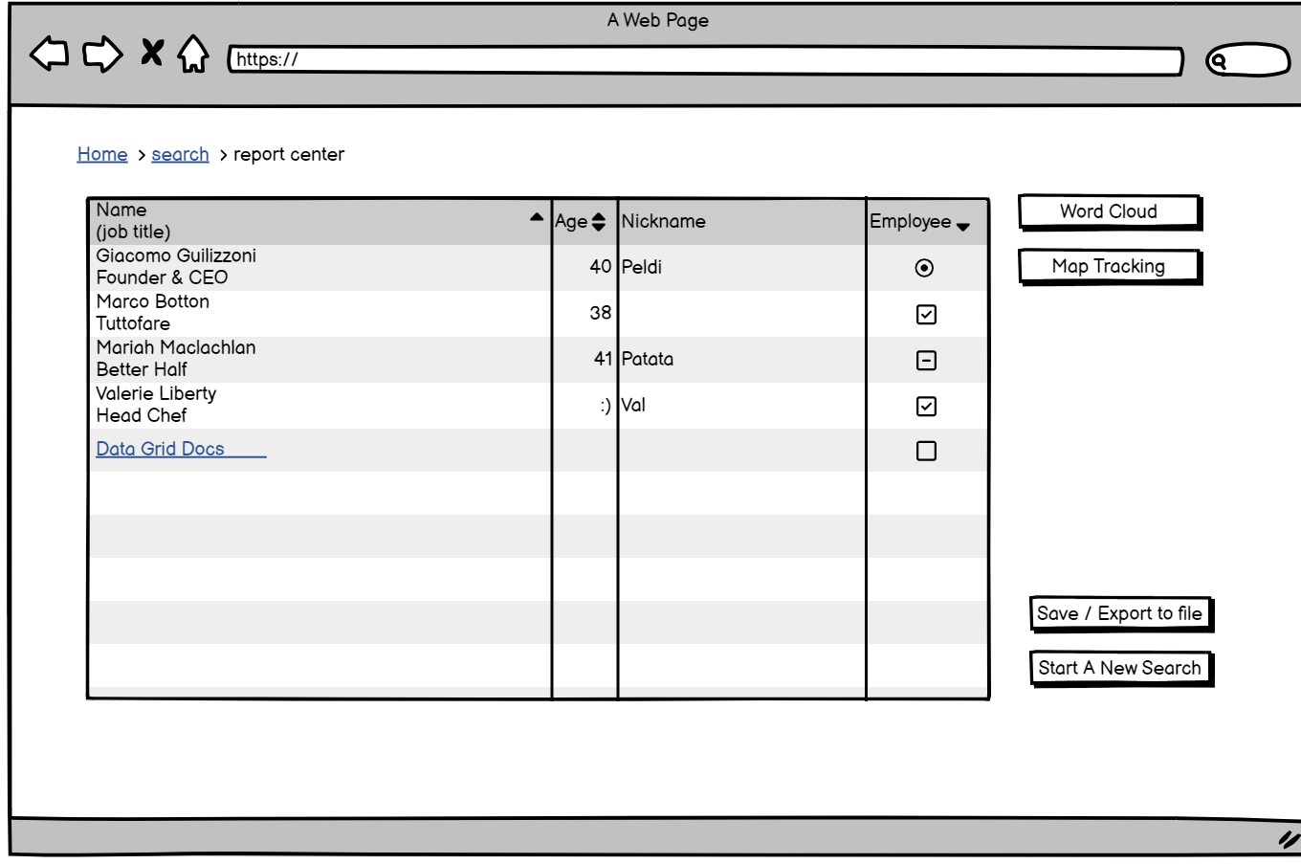
Current Design status:
New homepage
New search page
Results page

Slide 6
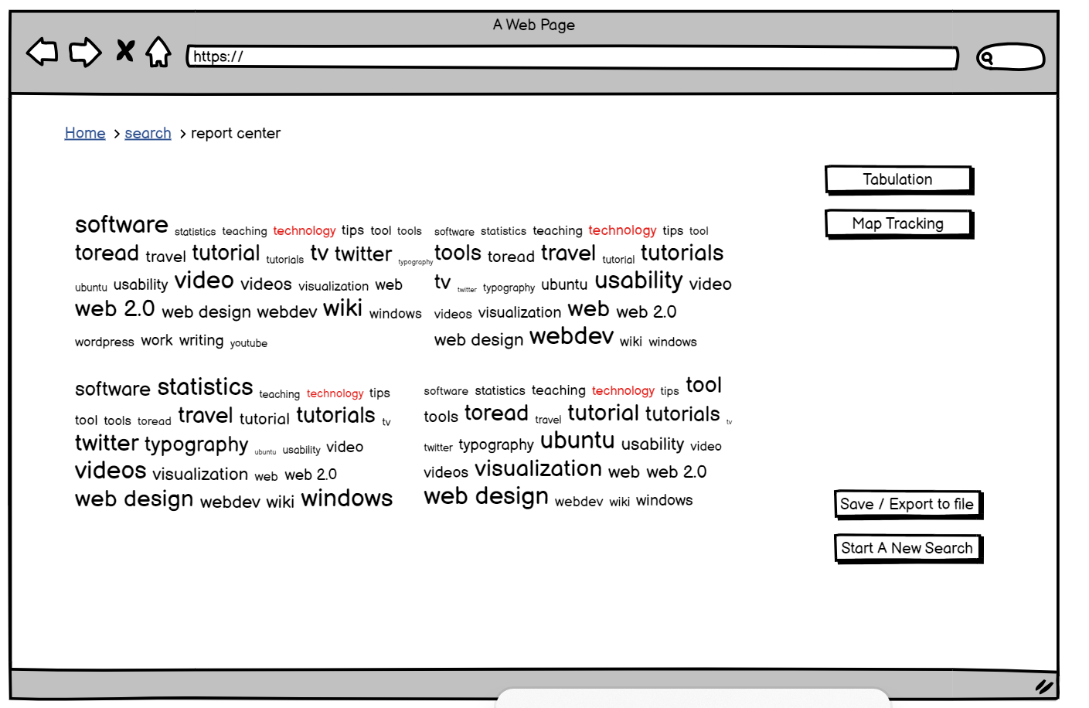
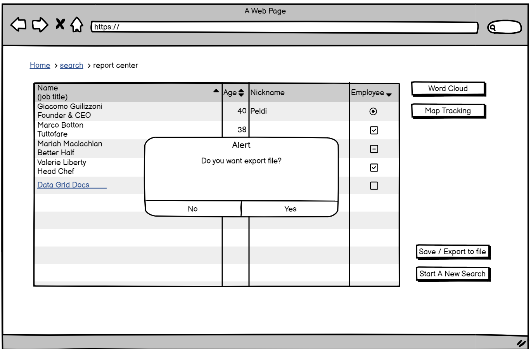
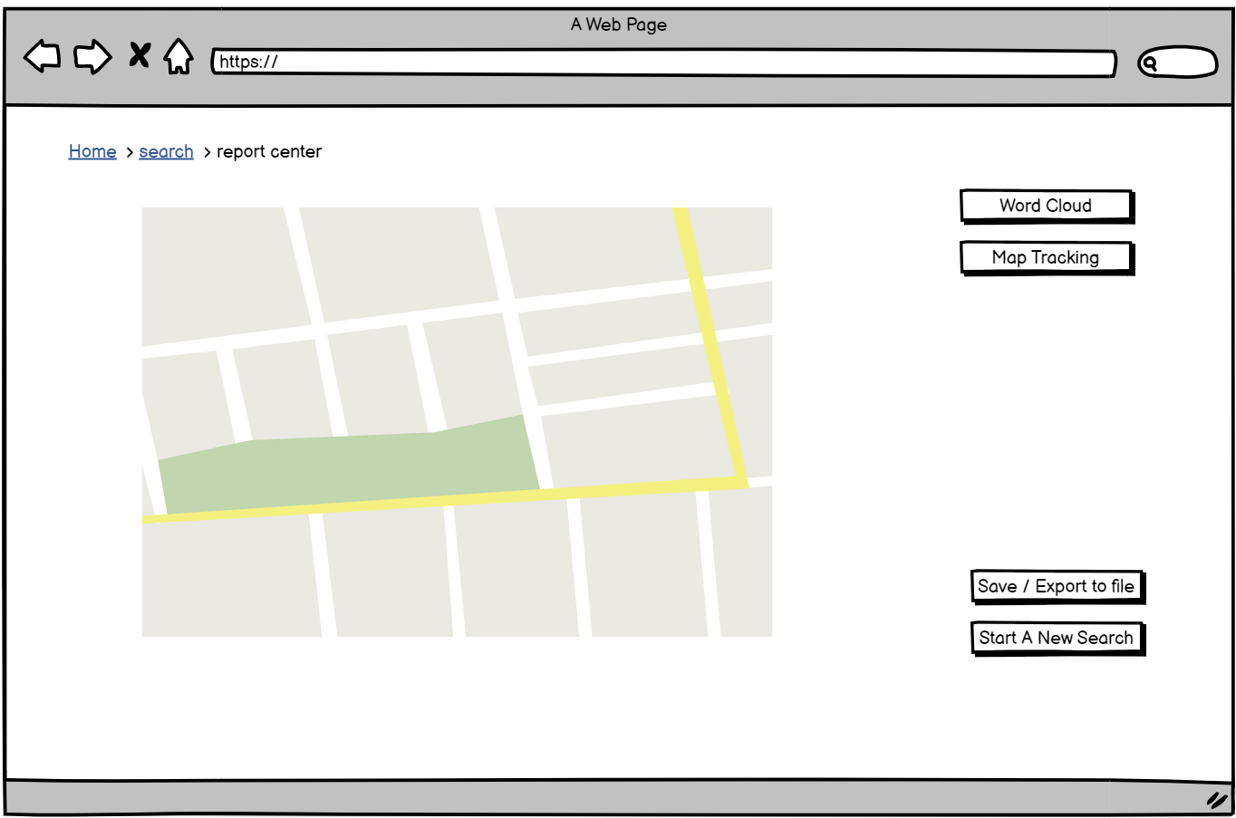
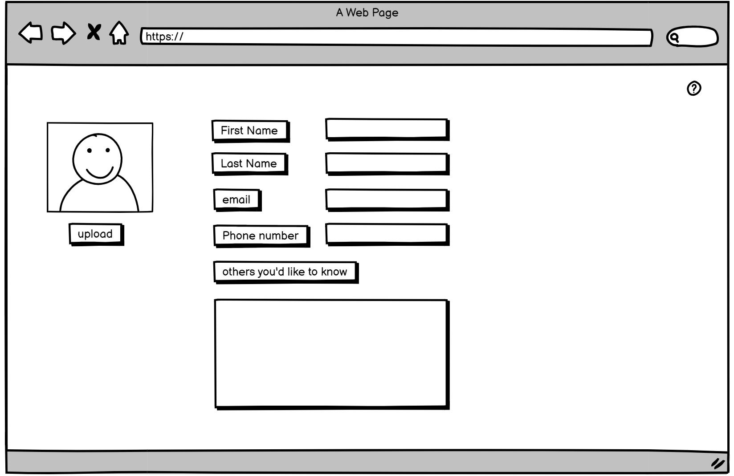
More new design:
Export function
Word cloud page
Users profile
Mapping page

Slide 7
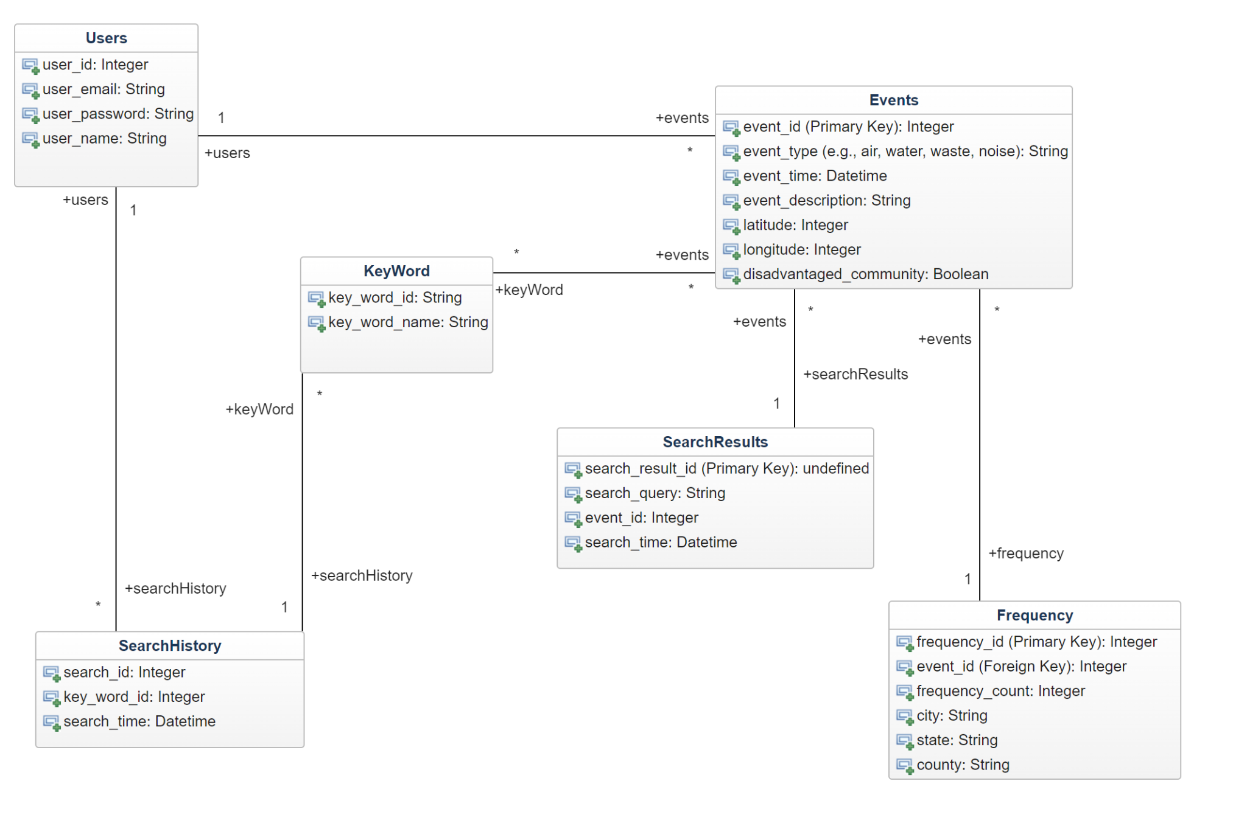
Database schema
What does what:
User: we have the user_id ( for tracking user purposes). User email to associate a user to an account. Additionally, I included a password and user_name for a profile if that is something we thought about doing. However, we can get rid of the password attributes and user name, etc.
Events: Events stores detailed information about individual pollution events, including their type, time, location, and description
KeyWords: This class stores a list of terms or keywords that are relevant to environmental pollution events. These terms could include words related to different types of pollution (e.g., air pollution, water pollution),
SearchResult: This class stores and tracks the results of search queries separately from the main ‘Events’table, providing a way to record which events were returned as search results and when the searches were performed.
SearchHistory: This records each search query made by users on our system. The Association I have placed links each search query to the specific term or word that was searched for. This is mainly in place for our word cloud visualization, with this we can identify popular search terms/terms selected.
Frequency: serves the purpose of tracking the frequency of occurrence for each pollution event so how many times a particular pollution event has occurred. This serves the purpose of tracking and analyzing the trends and when we are making the graphs to visualize the distribution of pollution events based on their occurrence in disadvantaged communities.

Slide 8
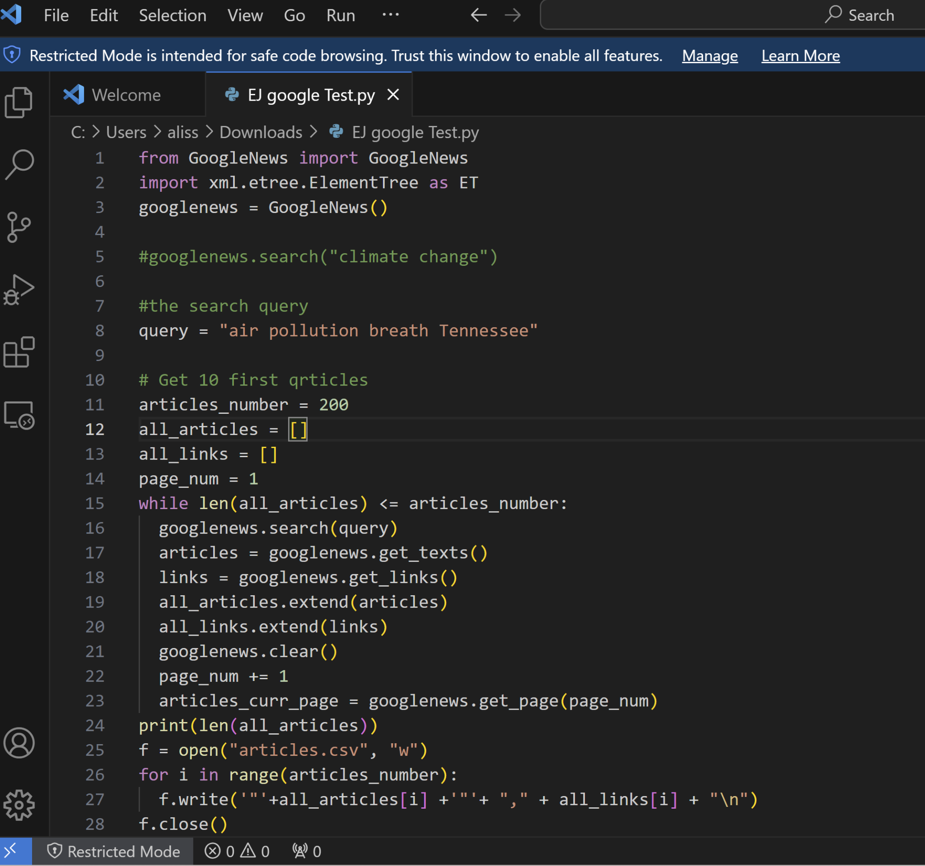
Urgent Needs- Small Scale test
Our client had an urgent need for results before we could implement it on a larger scale. We halted progress to work and provided him with smaller scale version of what he is asking of us.

Slide 9
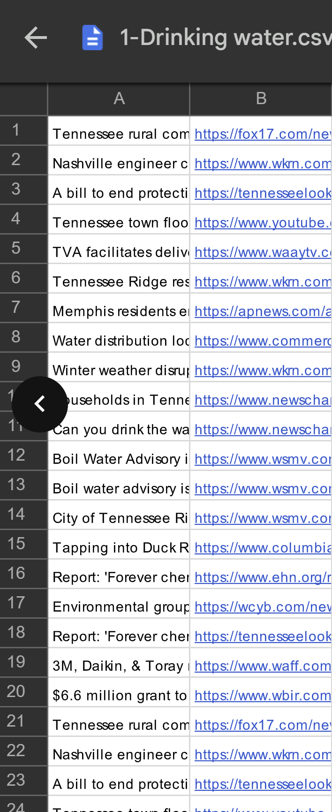
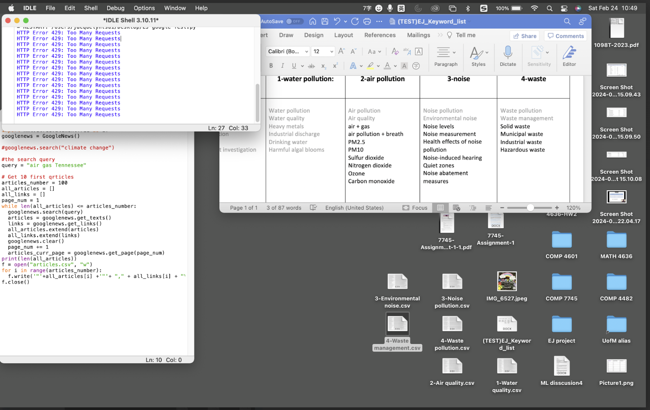
Results produced:

Slide 10
Demo Of Homepage:
and Current running code:

Slide 11
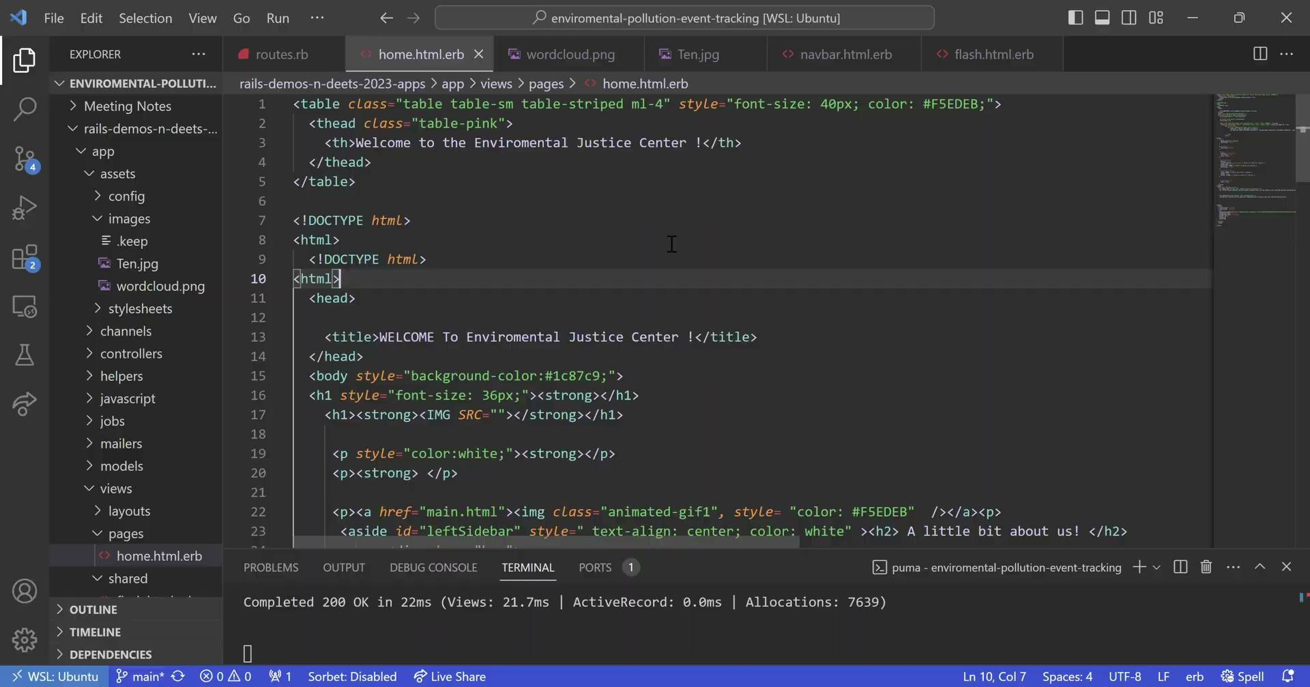

Slide 12
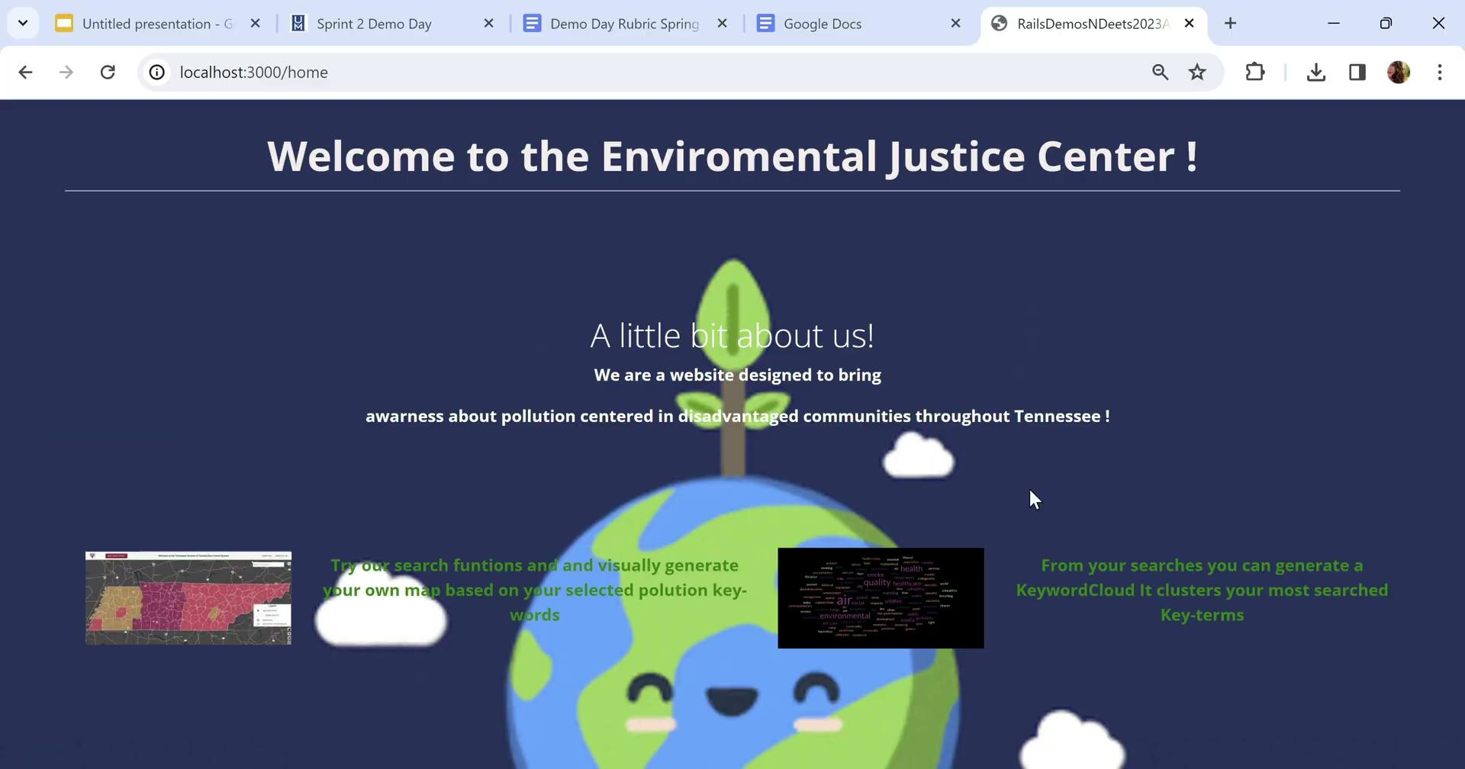

Slide 13
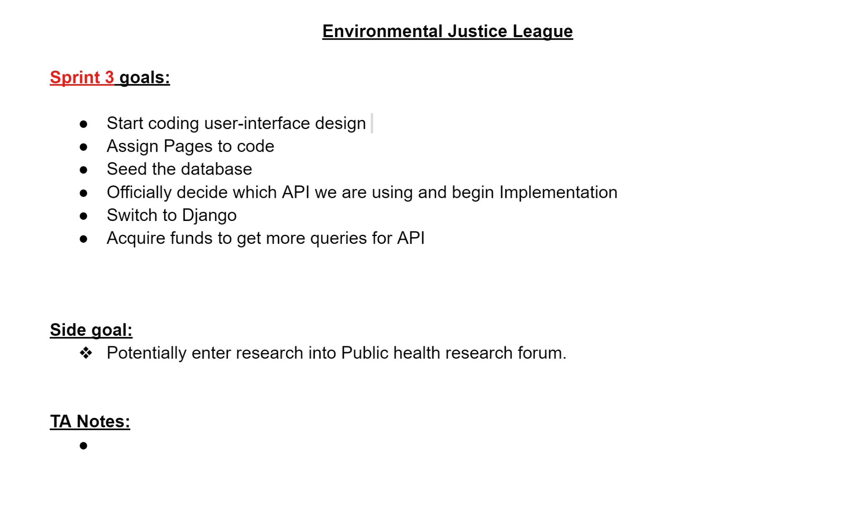
Goals For Sprint 3

